Slide 1

Anomaly Detection in Cardiotocograms using autoencoder.
Team Members: Zeel Parekh Parth Sathiya Mallikarjun Esnapur JayKumar Gondalia Ashiq Ashraf Puthiyaveetil

Slide 2
Contents
Objective
Dataset Overview
Data Preprocessing
Model Architecture
Evaluation Results
Hyperparameter Tuning
Scope of Improvement

Slide 3
Objective
To build an Anomaly Detection model for Cardiotocography (Cardio) Dataset using Autoencoder to get the best results in Anomaly Detection.

Slide 4
Dataset Overview
Dataset is sourced from open-source platform named UC Irvine ML repository. (Dataset URL)
The dataset consists of measurements of fetal heart rate (FHR) and uterine contraction (UC) features on Cardiotocograms classified by expert obstetricians.
Subject Area: Health and Medicine
Unsupervised Learning
Feature type: Real
Instances: 2126
Features: 21

Slide 5

Preprocessing
No missing values
Being a time series dataset, we did not find any insignificant features.
Featured Scalar: Standard Scaler
Data splitting 70:10:20
Random Shuffling

Slide 6
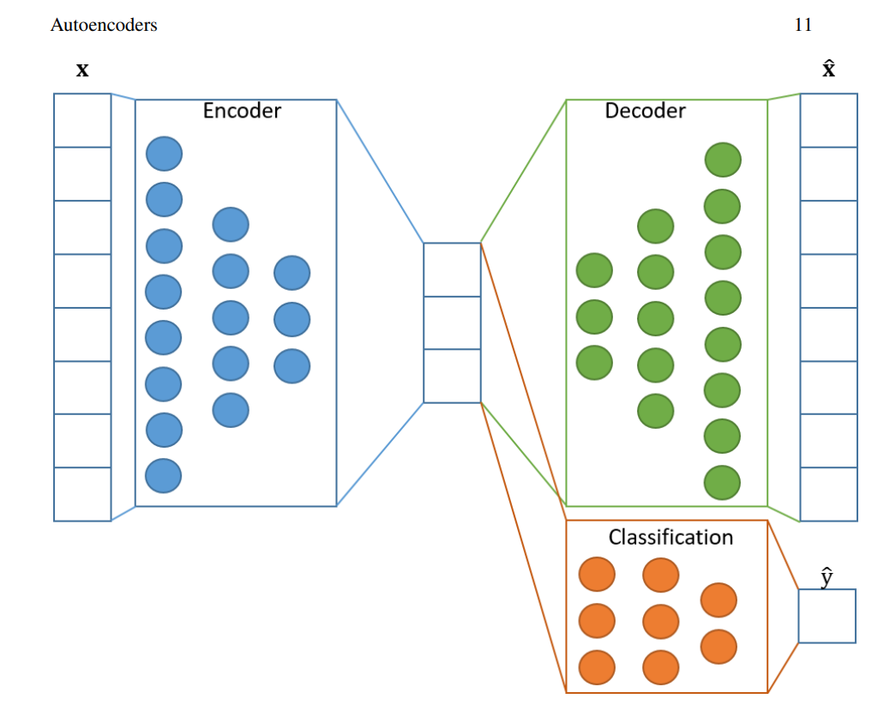
Model Architecture
Encoder:
2 Dense Layer, 1 Dropout Layer
Activation Function – Relu
Bottle Neck(z): 16 dims
Decoder:
2 Dense Layer
Activation - Relu
Optimizer - Adam
Loss: Mean Squared Error
ImageURL

Slide 7
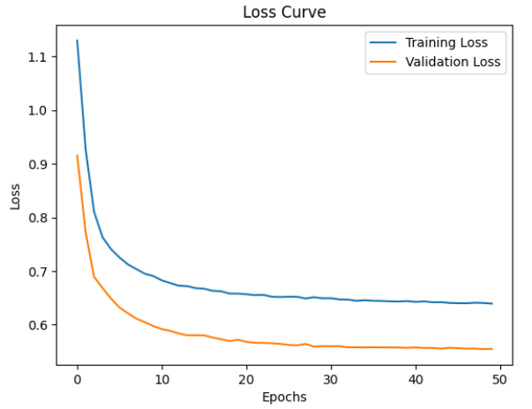
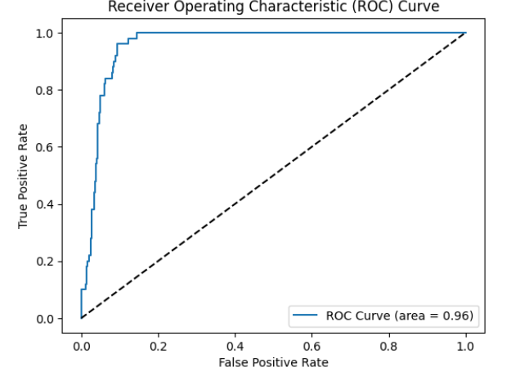
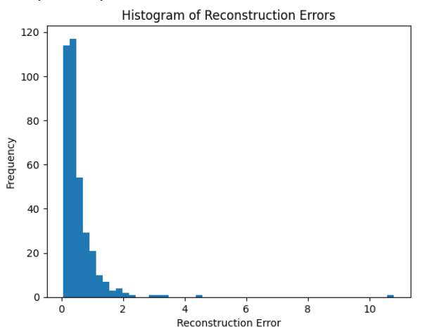
Evaluation Results

Slide 8
Hyperparameter Tunning
Hyperparameter | Value
Epochs | 50
Batch Size | 32
Encoding dimensions | 16
Dropout rate | 0.3
Learning | 0.03
Accuracy of anomaly detection: 91.55%

Slide 9
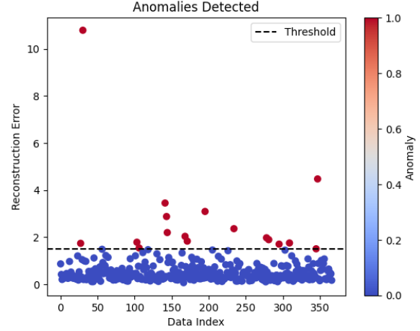
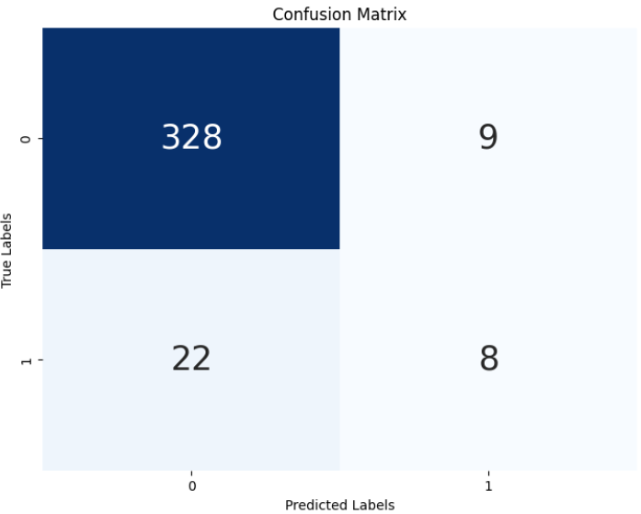
Results:
Threshold Value: 1.5

Slide 10
Scope of Improvement
In the context of reconstruction errors, a high “MLTV" value could indicate challenges in accurately capturing or representing the dataset's NSP values. It's essential for the device responsible for capturing MLTV to precisely capture this feature.

Slide 11
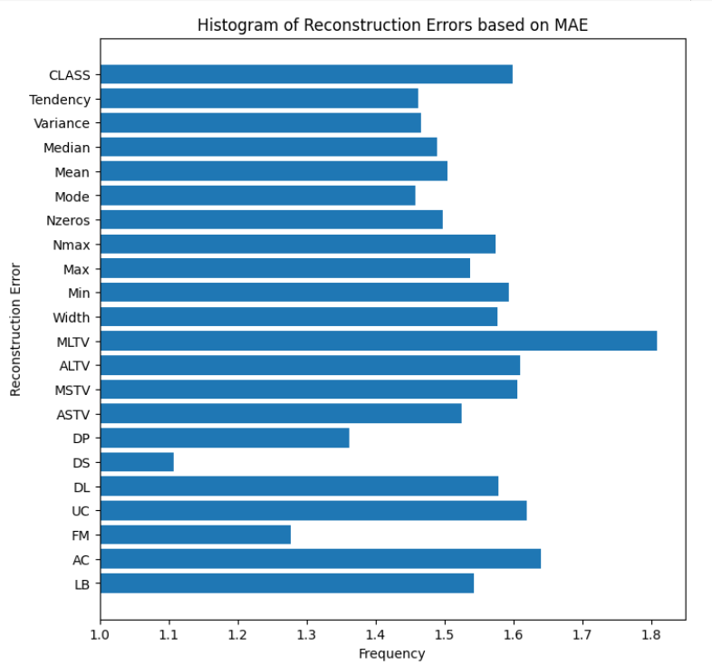
Most contributing features

Slide 12
Thank You!

